Slide 1


Defect Rate Early Identification

Slide 2
Objective:
Identifying which production steps are causing defect Rates (Drivers).
Predict defect rates for next 7 days in advance.

Slide 3
Project Flow
0. Data Understanding (Production Process)
1. Data Preparation
2. Exploratory Data Analysis
3. Model Building for Identifying causes
3.1 Regression
Identifying Drives (Features) of Defect Rate
3.2 Classification
5. Conclusion 1 & 2
4. Forecasting
ARIMA
&
SARIMA
Forecast Defect Rates for Next 7 Days

Slide 4
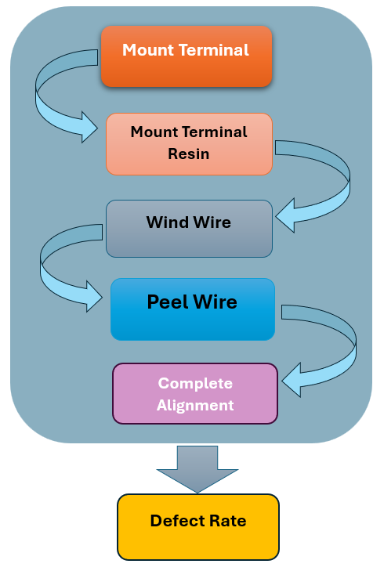
Production Process
Step - 0

Slide 5
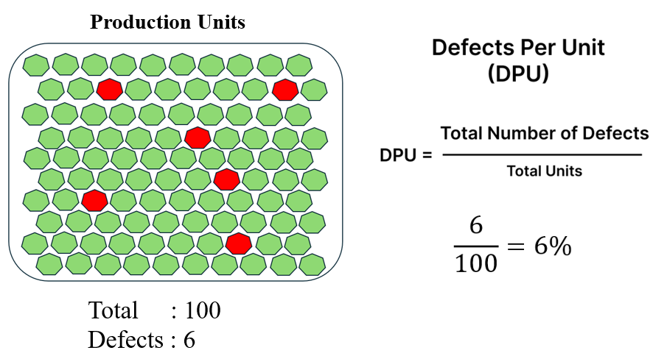
Defect Rate

Slide 6


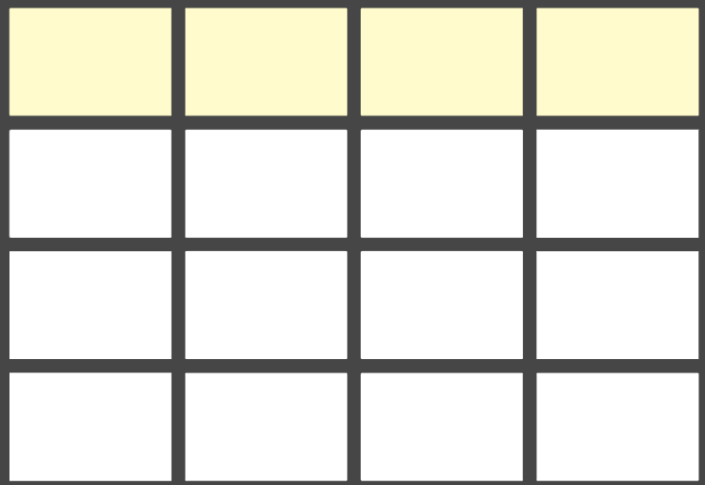
Data Preparation
Step - 1
Data Sorting & Concatenation
Mount Terminal
Mount Terminal Resin
Wind Wire
Peel Wire
Complete Alignment

Slide 7






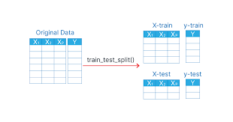

Exploratory Data Analysis
Step - 2
Dropping the columns
Adding Missing hour Information
Outlier Detection
Data Rolling
Adding Hour & Minute
Train Test Split
Standard Scaling

Slide 8

Model Building for identifying the causes
Step – 3.1
Regression
Best Model
MAPE : 0.00339
MAPE : 0.00340

Slide 9
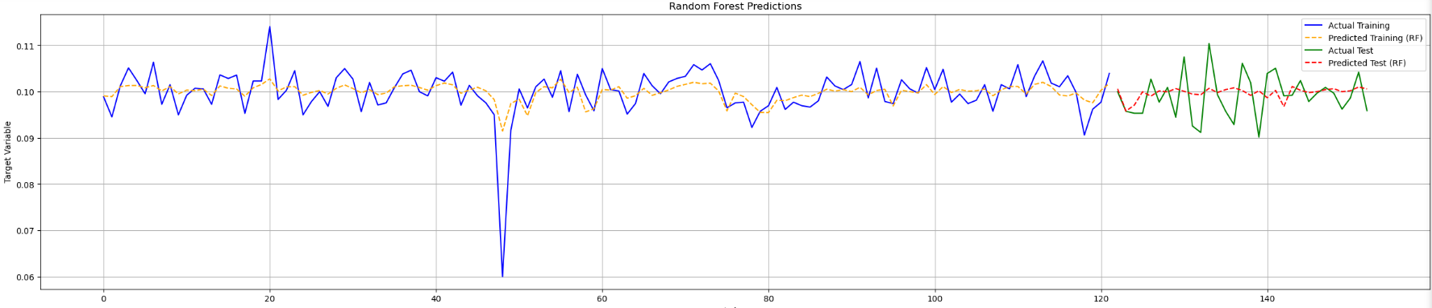
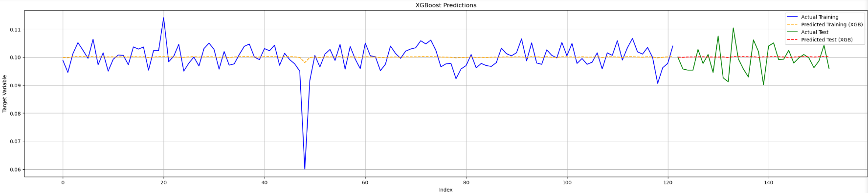
Actual vs Predicted

Slide 10
Step – 3.2
Classification
0
Below Average of Defect Rate
1
Above Average of Defect Rate
Best Model
F1 Score : 0.43
F1 Score : 0.32

Slide 11
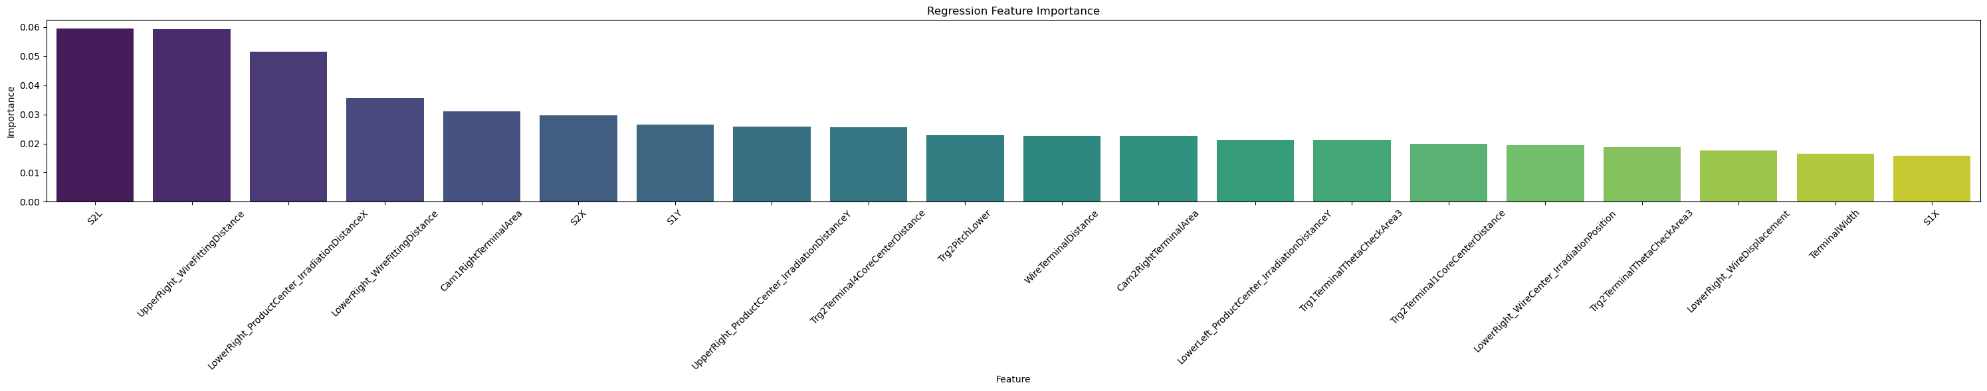
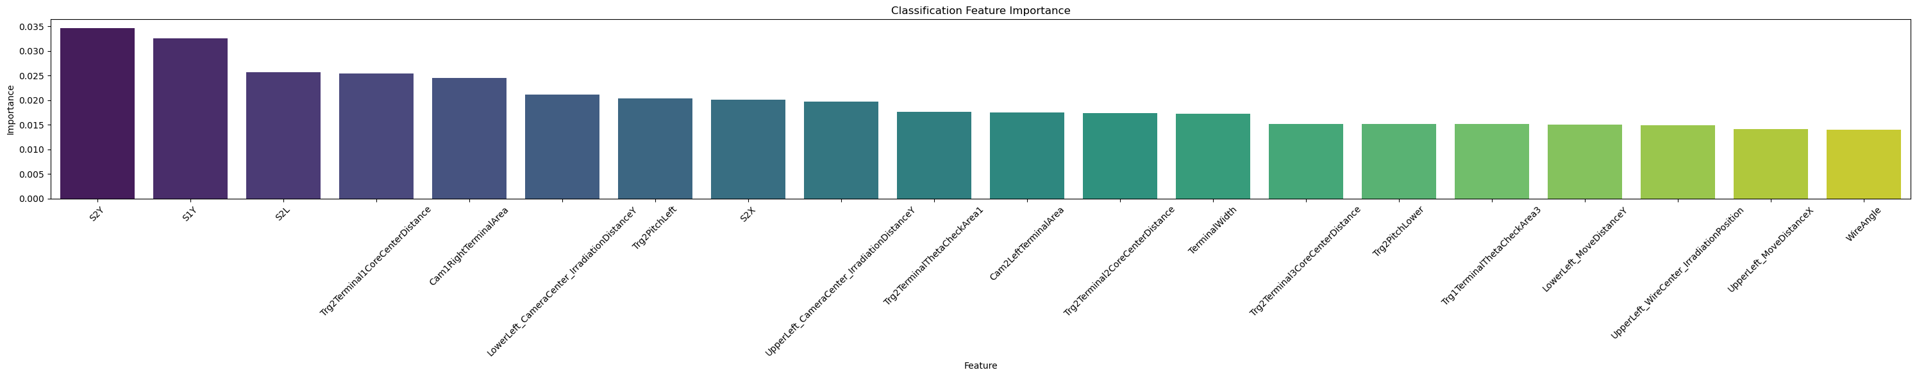
Feature Importance

Slide 12
Causes of Defect Rate
Conclusion – 1
Production steps contribute to the defective rate
26%
Step1 Mount Terminal: Trg2Terminal3CoreCenterDistance, Trg1Terminal4CoreCenterDistance, Trg2PitchLeft, Trg2PitchRight etc..
6%
Step2 Mount Terminal Resin: Cam1RightTerminalArea and Cam2RightTerminalArea etc..
20%
Step 3 Wind Wire: S1L, S2L, S2X, etc …
5%
Step 4 Peel Wire: WireTerminalDistance, TerminalWidth etc …
43%
Step 5 Complete Alignments: UpperRight_MoveDistanceX, LowerRight_MoveDistanceX, UpperRight_CameraCenter_IrradiationDistanceX etc…

Slide 13
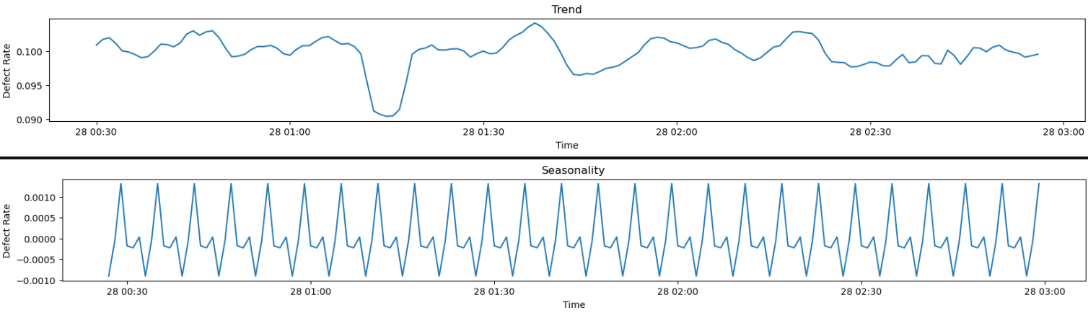
Defect Rate Prediction for the Next 7 Days
Step - 4
Time Series Decomposition Plots

Slide 14
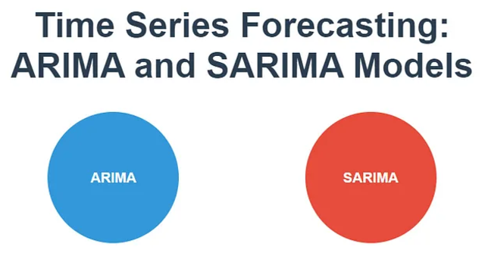
Time Series Forecast Models
Best Model
Vs
Order: (4, 1, 1)
Order: (2, 1, 2) (1, 1, 3, 6)

Slide 15
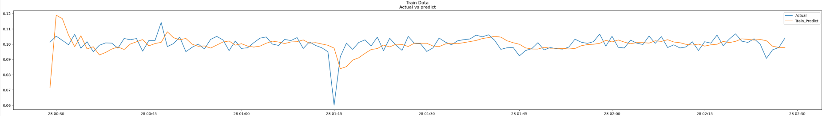
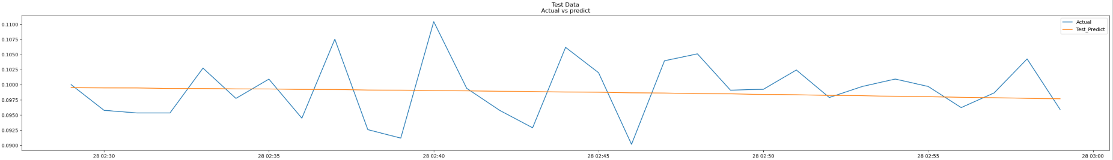
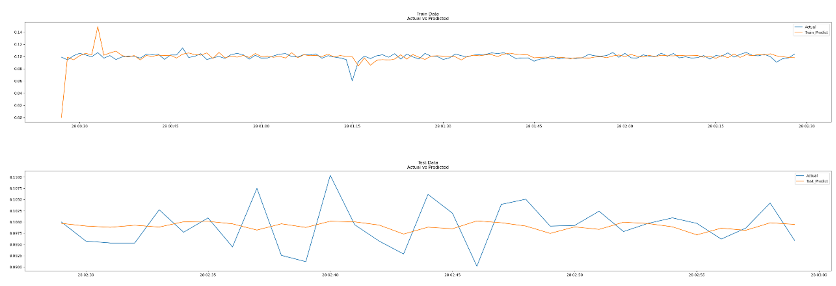
Actual vs Predicted Plots
AR IMA
S
ARIMA

Slide 16
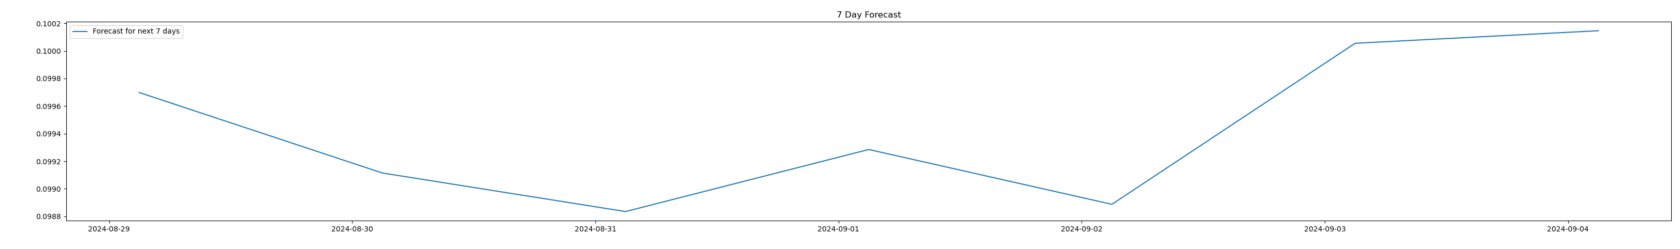
Forecast for the Next 7 Days
Conclusion – 2
The analysis of predicted defect rates over the next 7 days highlights that days 1, 4, 6, and 7 are expected to have high defect rates.
Focusing on steps 1, 3, and 5 of the production process can help reduce 90% defects, improving quality control and minimizing waste.

Slide 17
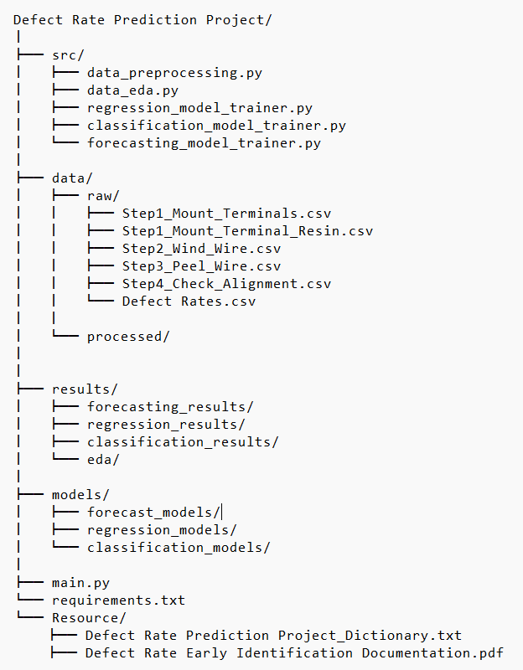

Appendix
main.py
Production Defect Rate
Train test split

Slide 18
Thank You

